Slide 1
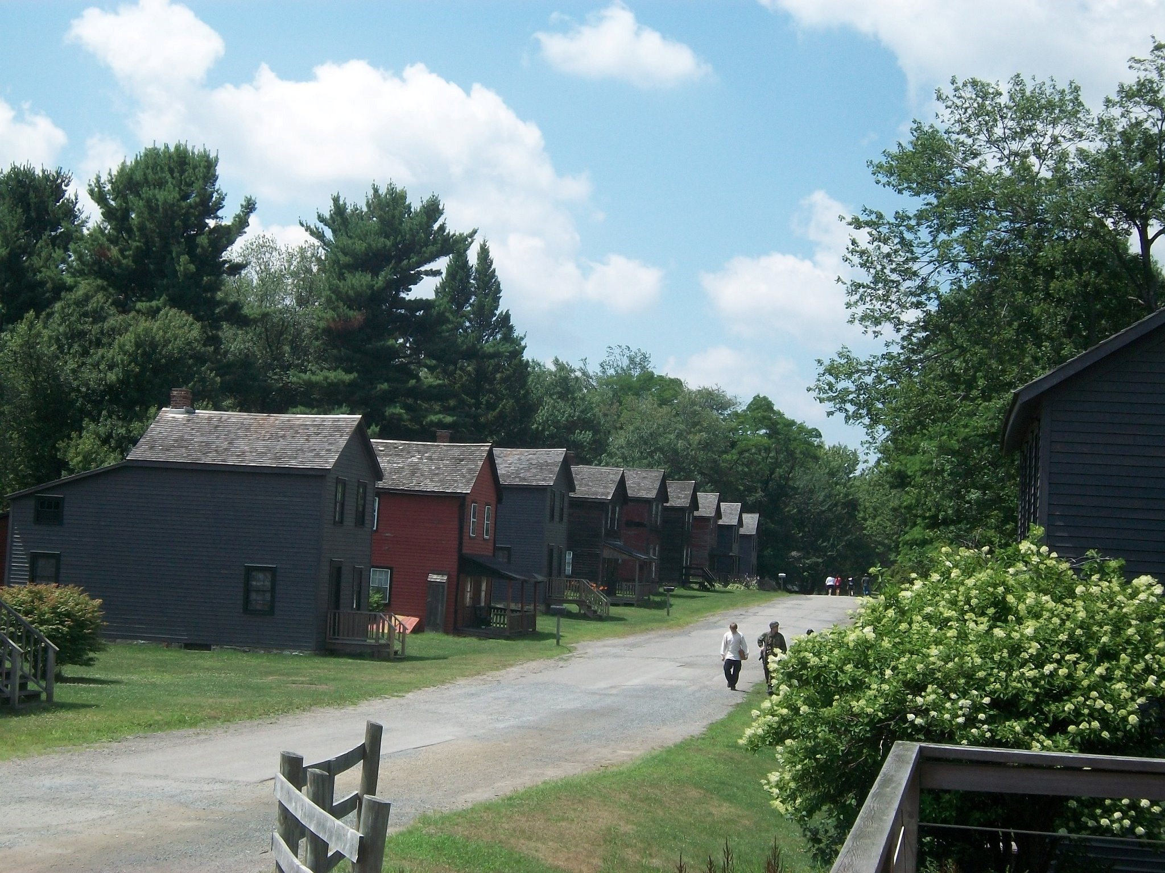
Eckley: a Historic Coal Mining Village

Slide 2
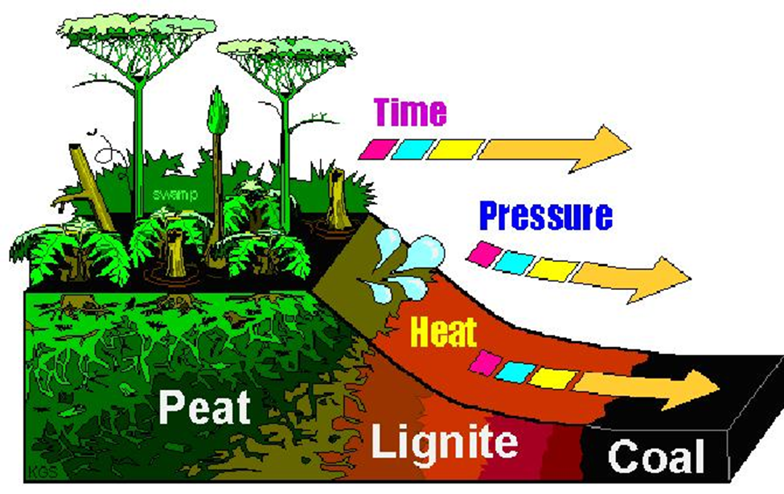
What is Coal?
Coal was formed millions of years ago. Plants in swampy areas would die and sink to the bottom of the swamp in layers. After time had passed these layers would turn into peat. Peat is a soil-like substance made of partially decomposed organic (living) material. Compression (the act of pushing something together) over millions of years caused the peat to undergo a process in which the hydrocarbon compounds break down and change. The gases caused by this change are usually released, and the deposit becomes more and more carbon-rich as the other elements disperse. This process is the reason why coal is called a “fossil fuel”.

Slide 3
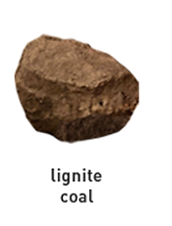
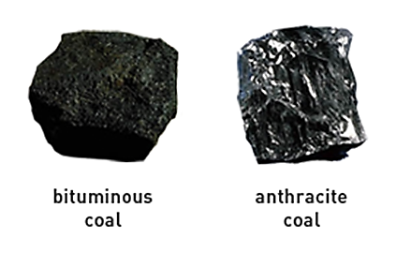
What Kinds of Coal are There?
There are three main types of coal. The first is called Lignite. It has the lowest carbon content and gives off the least amount of heat. The next kind of coal is Bituminous, which is also called “soft coal” and is the most common. This Bituminous coal is easily burned and good for heating. Anthracite is the most valued kind of coal since it has the highest carbon content and is the best for heating. Anthracite is very hard and shiny. It takes longer to catch fire, but burns longer and with less waste.

Slide 4
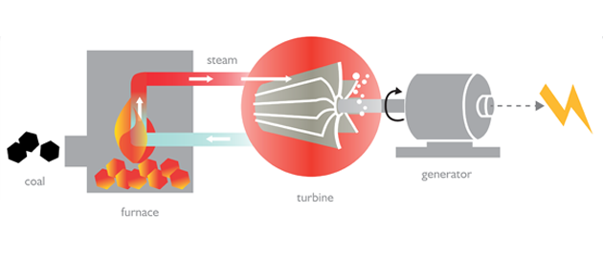
What is Coal Used For?
During the 1800’s and early 1900’s, coal was the main source of energy for industry and transportation. Coal was also used to power steam engines, melt iron ore, and produce heat for homes or businesses . Coal still is used to generate energy and heat homes today.
Here is an example of how coal is used to produce electricity.

Slide 5
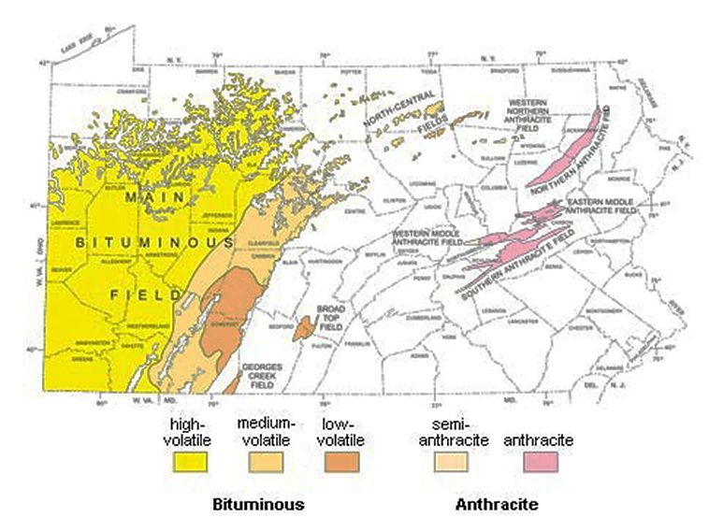
Where is the Coal?
Most of the coal in the United States is bituminous. Anthracite coal is found in only a few spots. One of these spots is in Pennsylvania. In the 1780’s, Tench Coxe began aquiring land in northeast Pennsylvania where this anthracite can be found. When these anthracite fields were discovered, they were seen as a huge opportunity for businesses and in 1854 a group of four business men (Foster, Leisenring, Sharpe, and Weiss) leased the land from the Coxe family and opened the mine at Eckley.

Slide 6
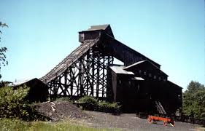
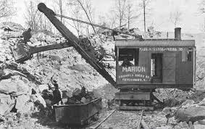
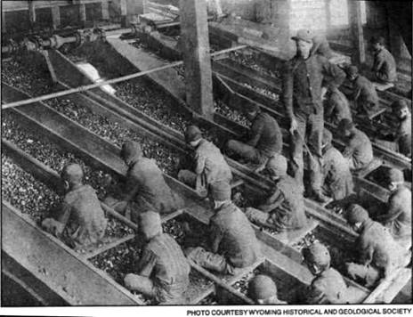
How was the coal Mined?
A “shaft” or passageway, was created from the surface to the underground place where the layers of coal were located. The miners and mules were then lowered down this shaft. The miners picked and blasted the coal out of the rock while the laborers loaded the coal into carts, which were pulled by the mules. Sometimes coal was even dug out of the ground using big steam shovels. After a cart was full, it would be hauled out of the mine and up a building called a “breaker.” The coal was dumped into rollers that would crush the coal into smaller pieces, then deposit them down a slope. Breaker boys would sit on the slope and pick out pieces of rock.

Slide 7
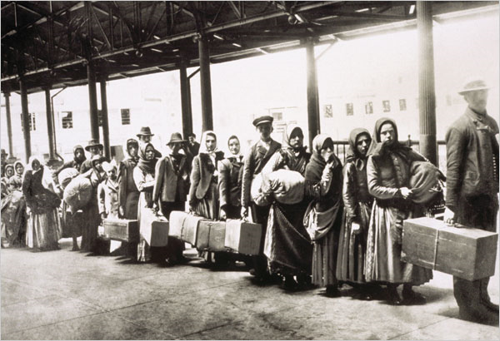
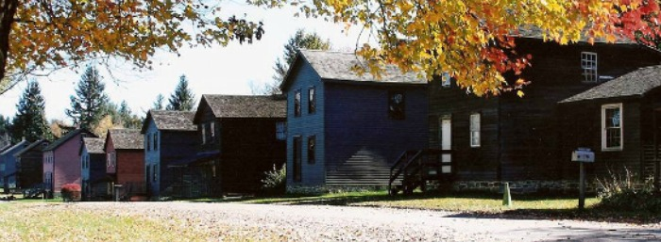
Who Mined the Coal?
When the mine opened, a Patch Town formed. A “patch town” is a village that is located in a remote area around a coal mine and owned by the mining company. The mines were owned by Americans, but most of the people who worked in the mines were immigrants. An immigrant is someone who leaves their homeland and moves to another country.

Slide 8
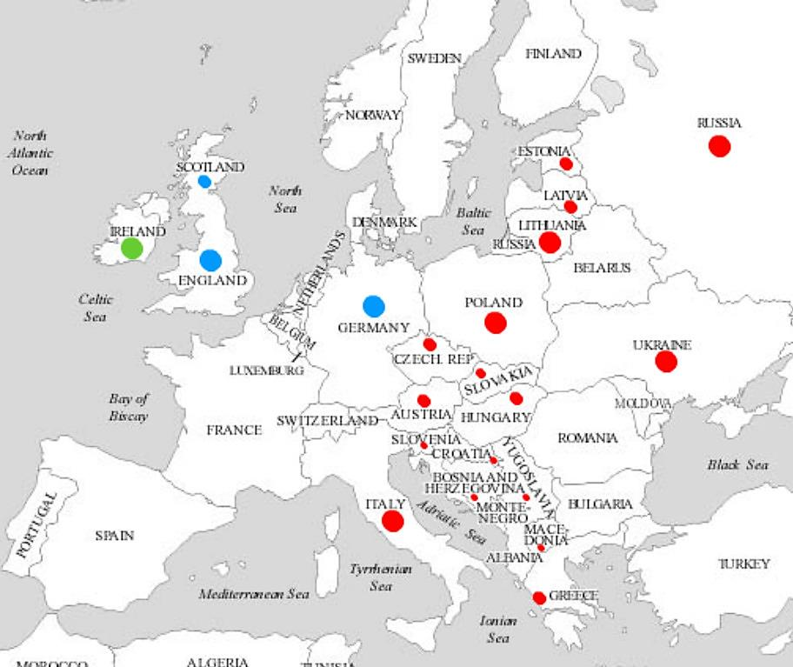
At first, the mine owners brought in immigrants from England and Wales who had experience with mining. Later, a wave of Irish immigrants flooded into America due to the potato famine. They became the new laborers before they worked their way up through the company. From the 1860’s to 1880’s another wave of immigrants came in from Eastern Europe. These people took the place of the Irish as the unskilled laborers.
1st Wave =
2nd Wave =
3rd Wave =

Slide 9
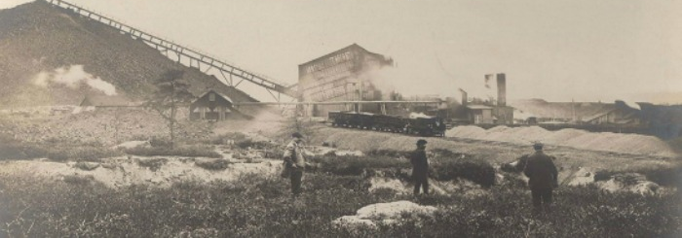
When these immigrants left their homes, they had to leave most of their belongings, and many times their families, behind. They would board a ship that would bring them to an Immigrant Inspection Station in the United States. These inspection stations asked immigrants questions like name, occupation, and the amount of money carried. Officials wanted to make sure that these newcomers had enough money to get started (between $18-$25). People in poor health were often sent home, or held in facilities until they had recovered. After they had made it through inspection, it was up to the new immigrant to figure out how to get from the coast to Eckley.

Slide 10
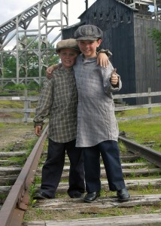
What’s Next?
Now that you know a bit about the history of coal, it’s time to visit Eckley Miners’ Village and find out about what life was like for people who lived in a Pennsylvania Patch Town!

