Slide 1
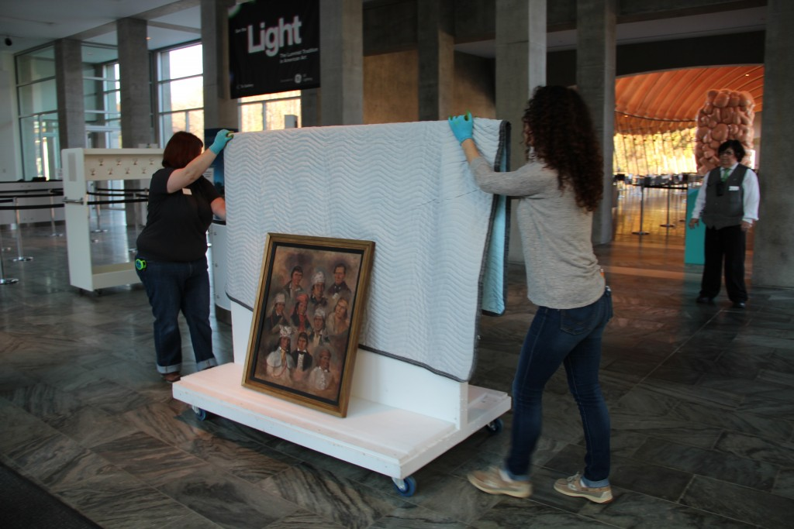
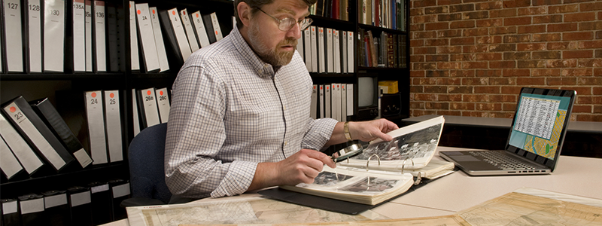
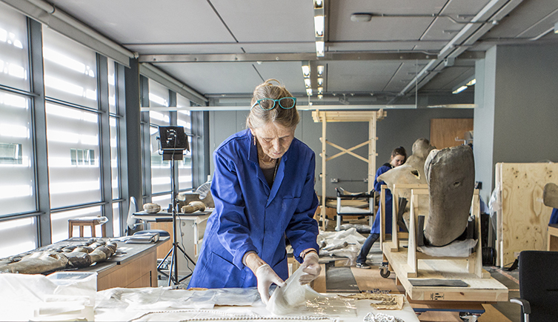
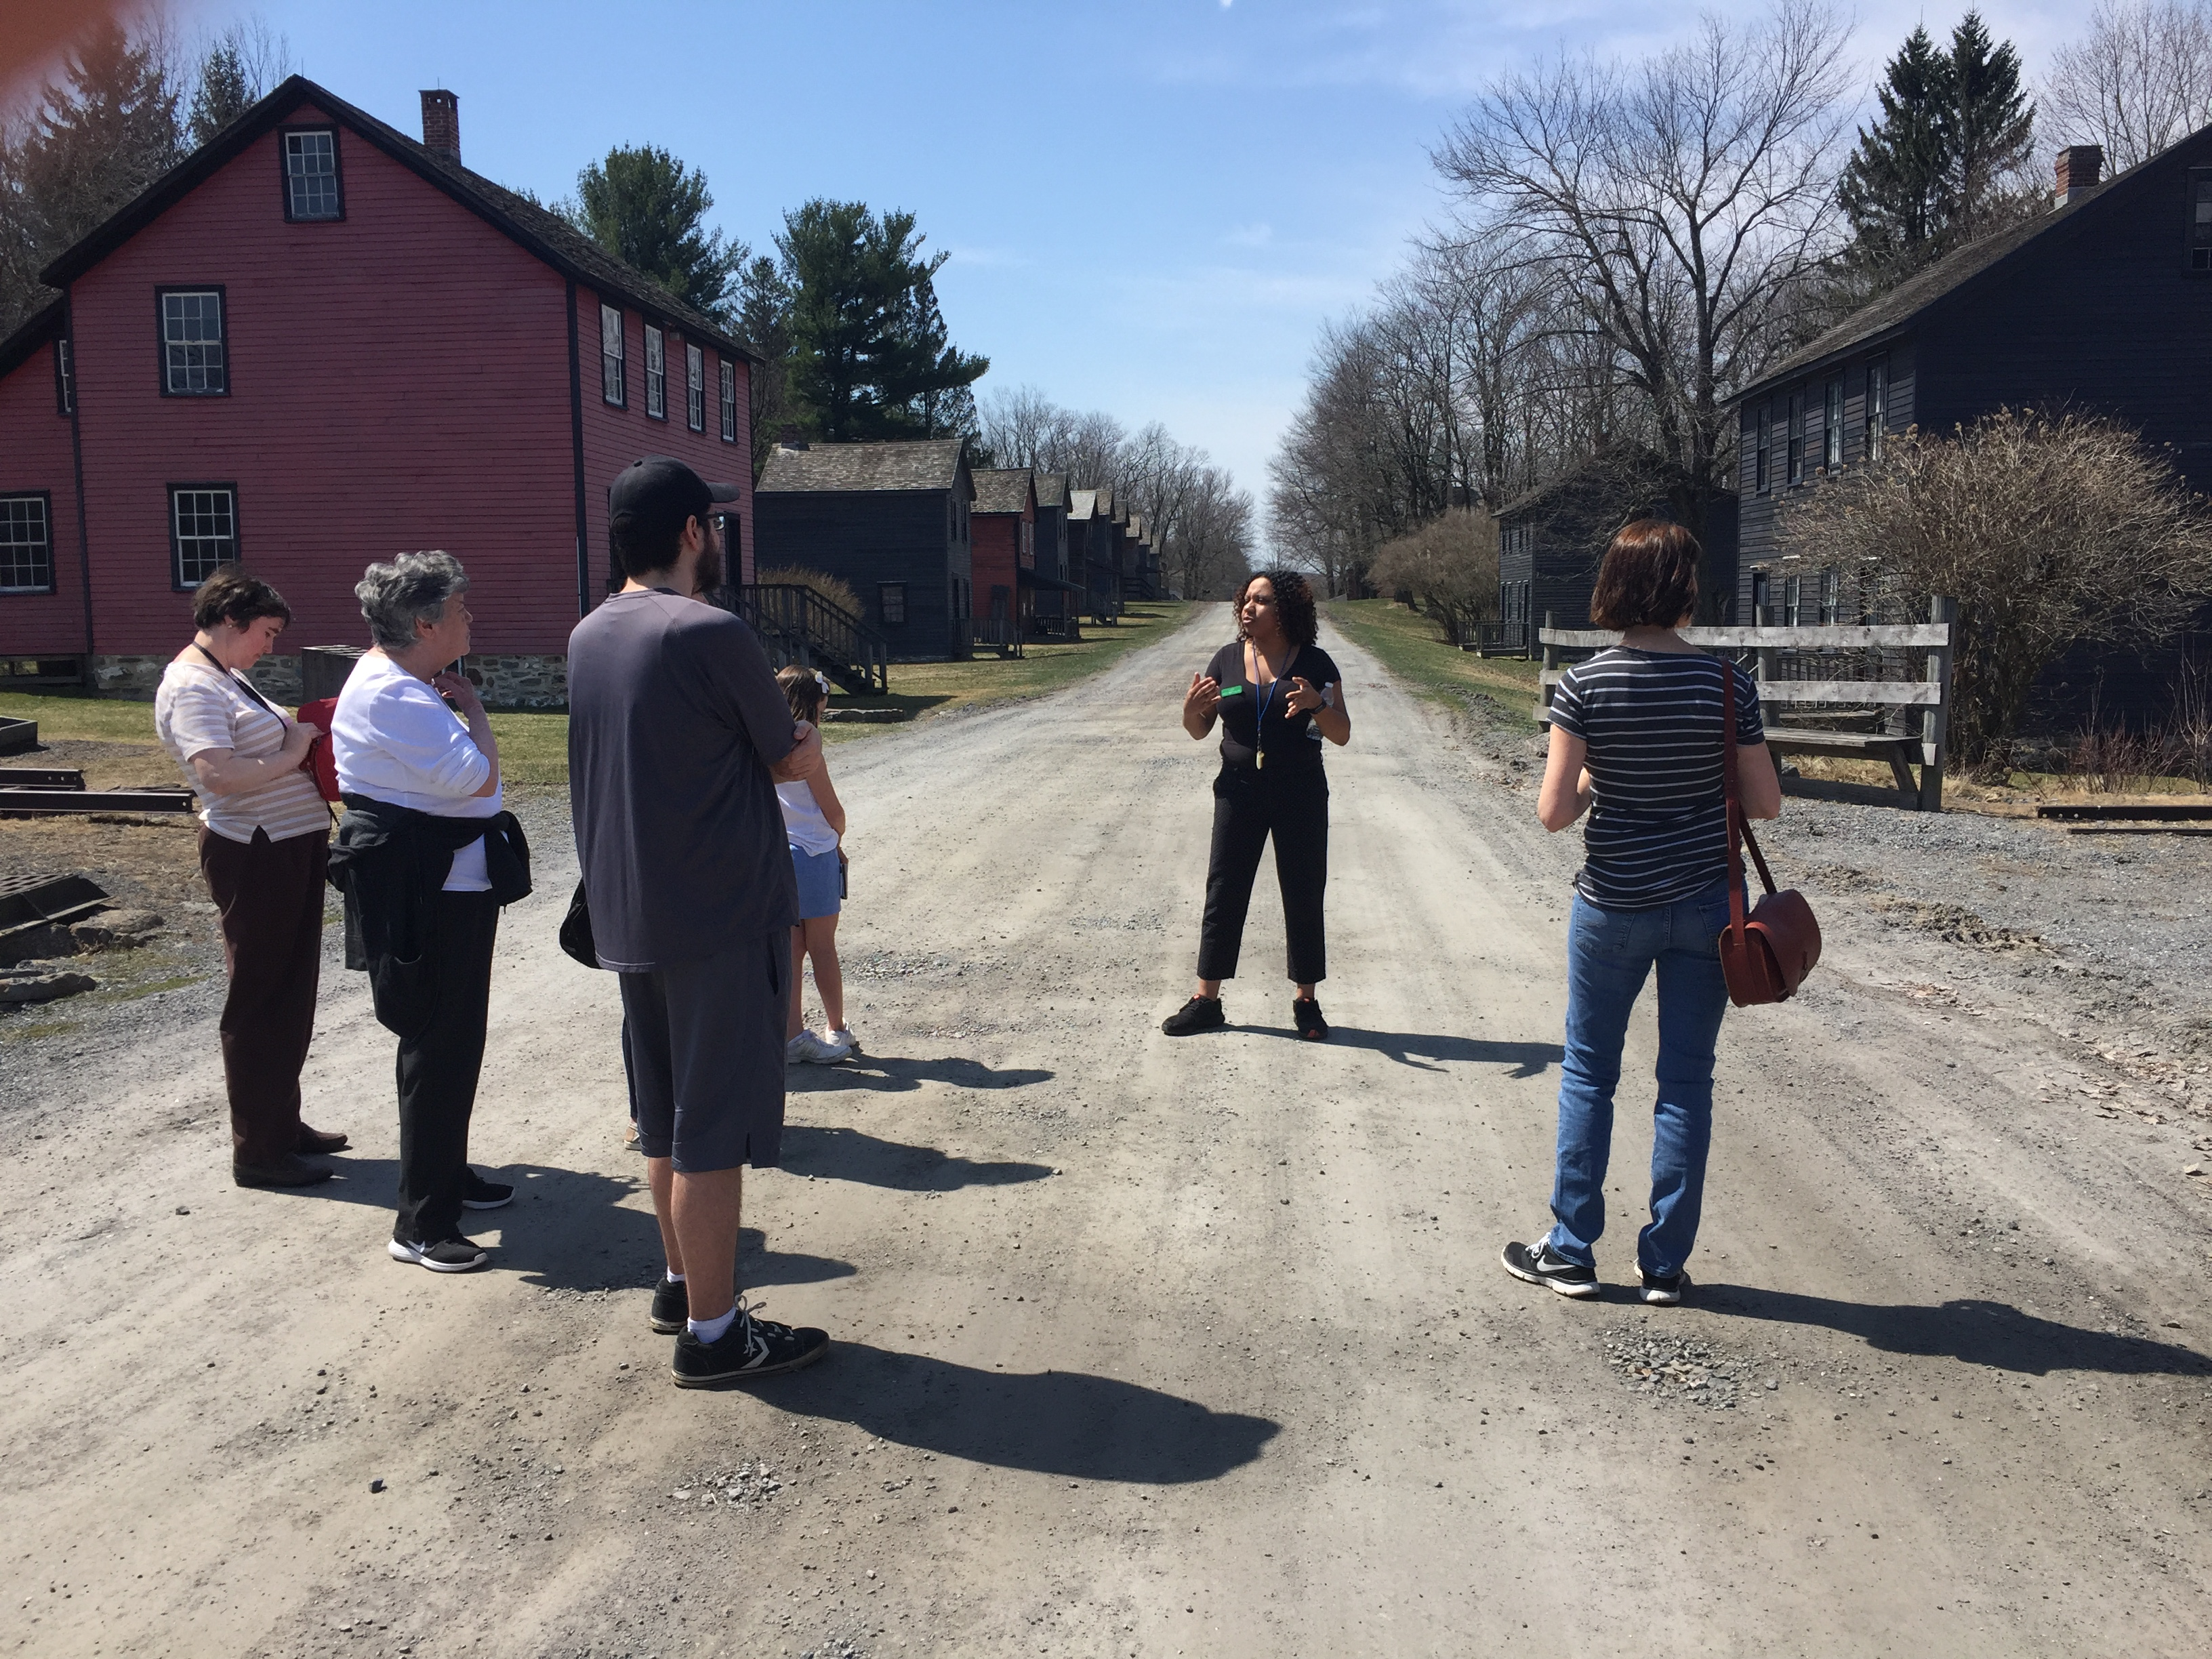
Museum People
Exploring Museum Careers
Nicole Negron_ Education and Volunteer Coordinator_ Eckley Miners’ Village Curriculum (2019)
Notes:
Thank you using this presentation. The focus of this presentation is to introduce students to the different museum careers as well as what formal training and education is required of each position. Refer to associated lesson plan for standards met by this presentation as well as important vocabulary.
Using this presentation:
(Text in parenthesis are directions for presenter, not to be read aloud.)
Introduce presentation however you deem fit.
Example introduction to presentation:
Today we are going to learn about different career options. In particular, we are going to discuss the various jobs in the museum field. We will talk about different kinds of museums, different jobs available in museums, and the education and training paths to these careers.

Slide 2
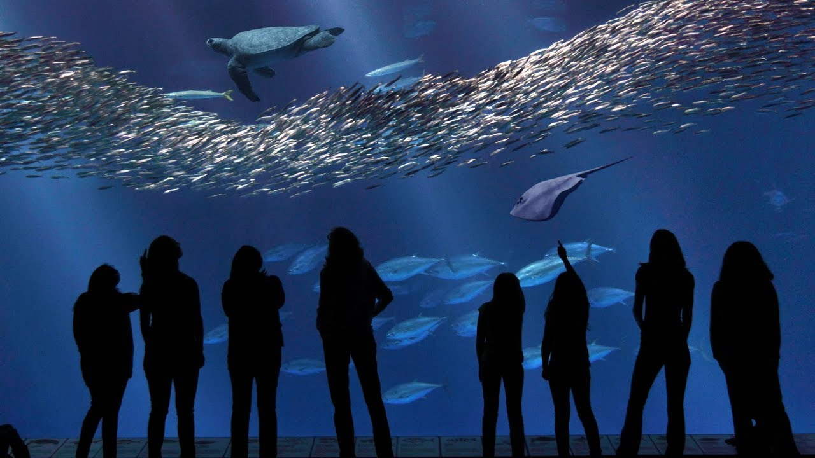
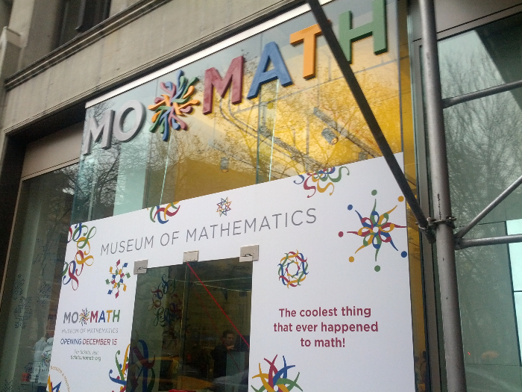
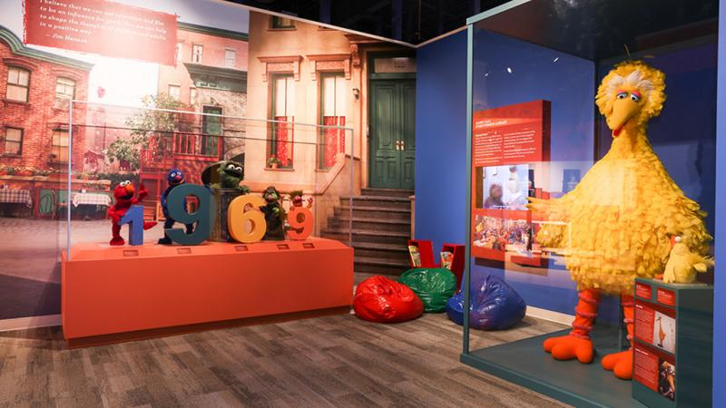
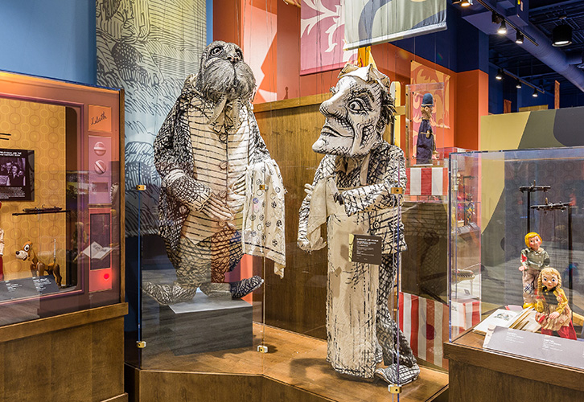
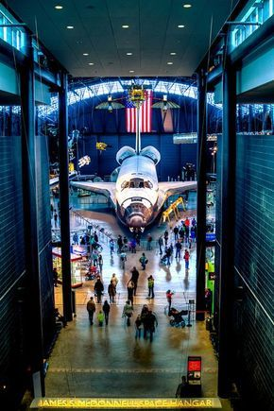
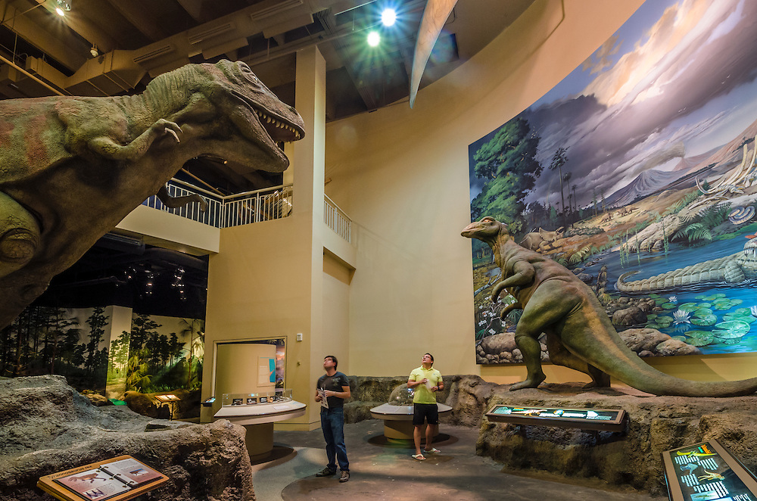
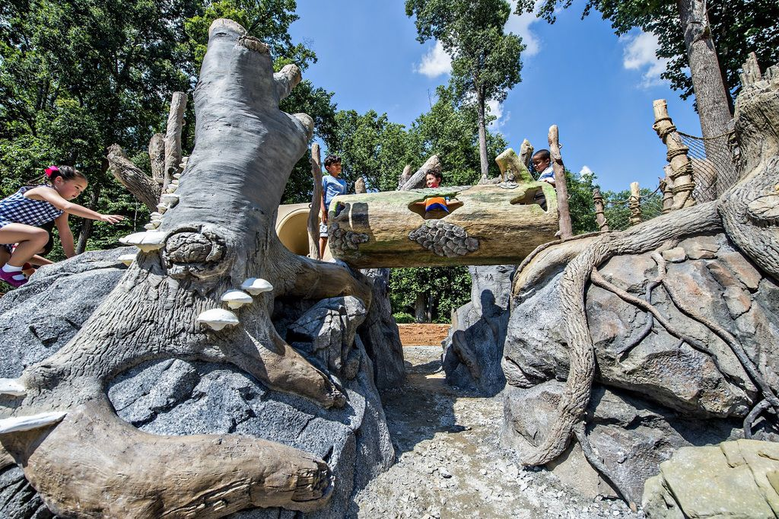
If you are interested in…
Math
Science
Airplanes
Puppets
Animals
Working with children
Art
Crafting and Carpentry
Web Design
History
Notes:
Have any of you ever been to a museum? What are some of your favorite museums? (Give students a chance to answer these questions. It will help foster interest in the topic.)
(Click to make topics list appear.) If you are interested in math, science, airplanes, puppets, animals, working with children, art, crafting, construction, and design, web design, and/or history, then hooray, you can work at a museum. Almost any topic you are interested in can bring you to a career at a museum.
(Once you start naming museums, click next to make photographs from museums appear.)
There are museums such as the National Air and Space Museum, Fernbank Natural History Museum, Museum of Mathematics, Monterey Bay Aquarium, and the Center for Puppetry Arts.

Slide 3
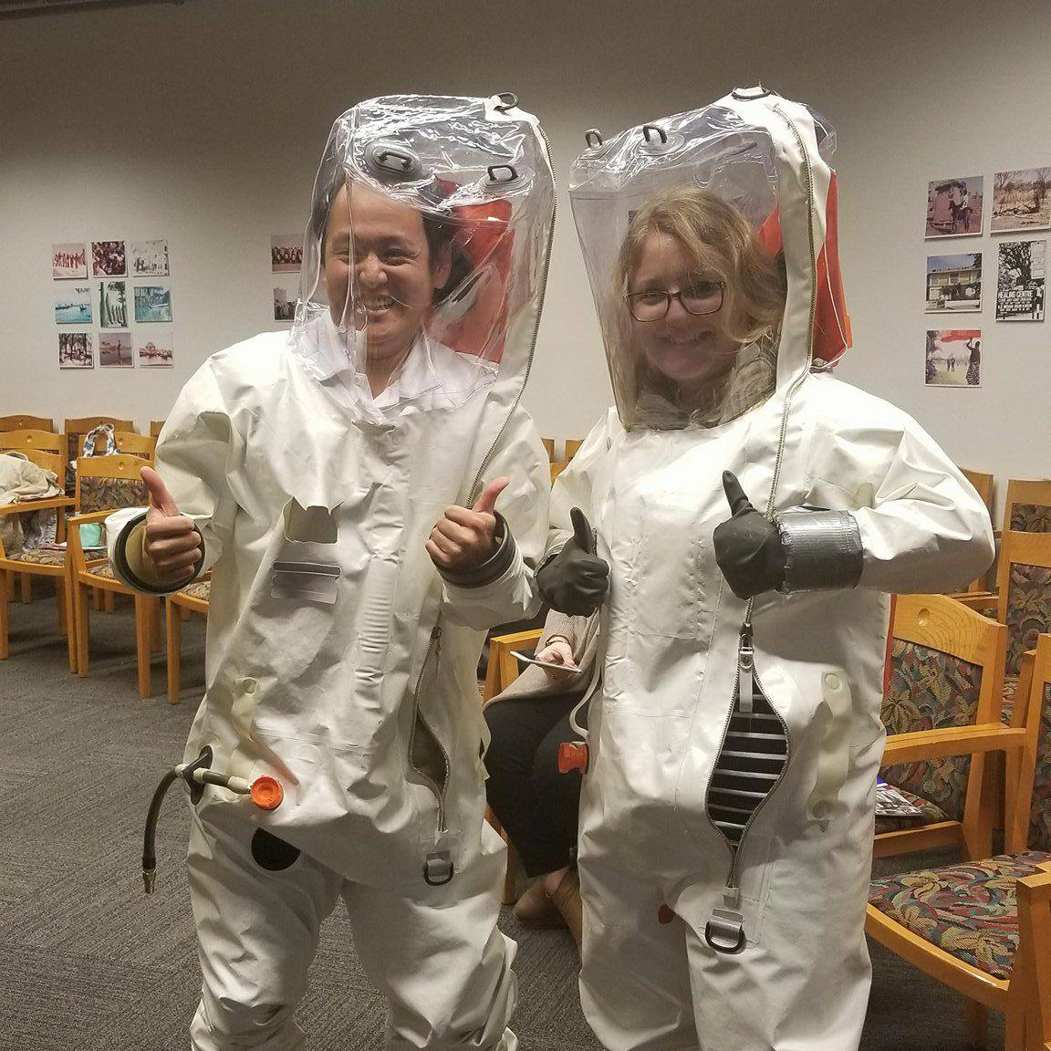
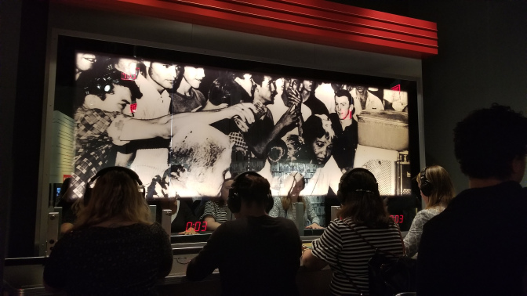
Museums are cool places to work…
What do you think of when someone says the word museum?
What kinds of things can you see and do at a museum?
Notes:
What do you think of when you hear the word museum? What kinds of things can you do and see at a museum? (Let students answer questions.)
(Click to bring pictures up.)
Yes, museums have dinosaurs and text panels with scientific words, but they also have music, outdoor exploration, and other interactive things to do. Some cool examples include:
At the Center for Civil and Human Rights, you can sit at a lunch counter, put the headphones on, and get a glimpse into a 1960s sit-in protest against segregation. Through the headphones, you can listen to some of the racial slurs that were yelled at protestors, feel the bump and vibration of the seats as if someone were kicking and pushing at you.
At the Fernbank Natural History Museum, children can play in a playground where all of the equipment is shaped and patterned like the native trees, leaves and other natural formations. The animal life is also carved into the landscape.
At the CDC Museum, one can not only learn about major epidemics and outbreaks, but also step into the protective gear sometimes worn when addressing these medical events.
Links to photos
https://goo.gl/images/6tGFe6
http://www.gpb.org/blogs/education-matters/2015/12/11/the-center-for-puppetry-arts-opens-the-new-worlds-of-puppetry
http://www.puppet.org/programs/museum/

Slide 4
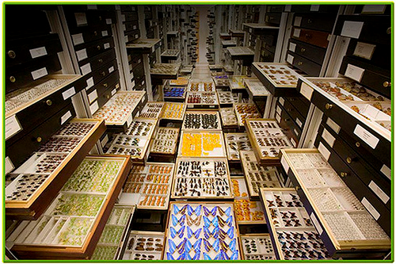
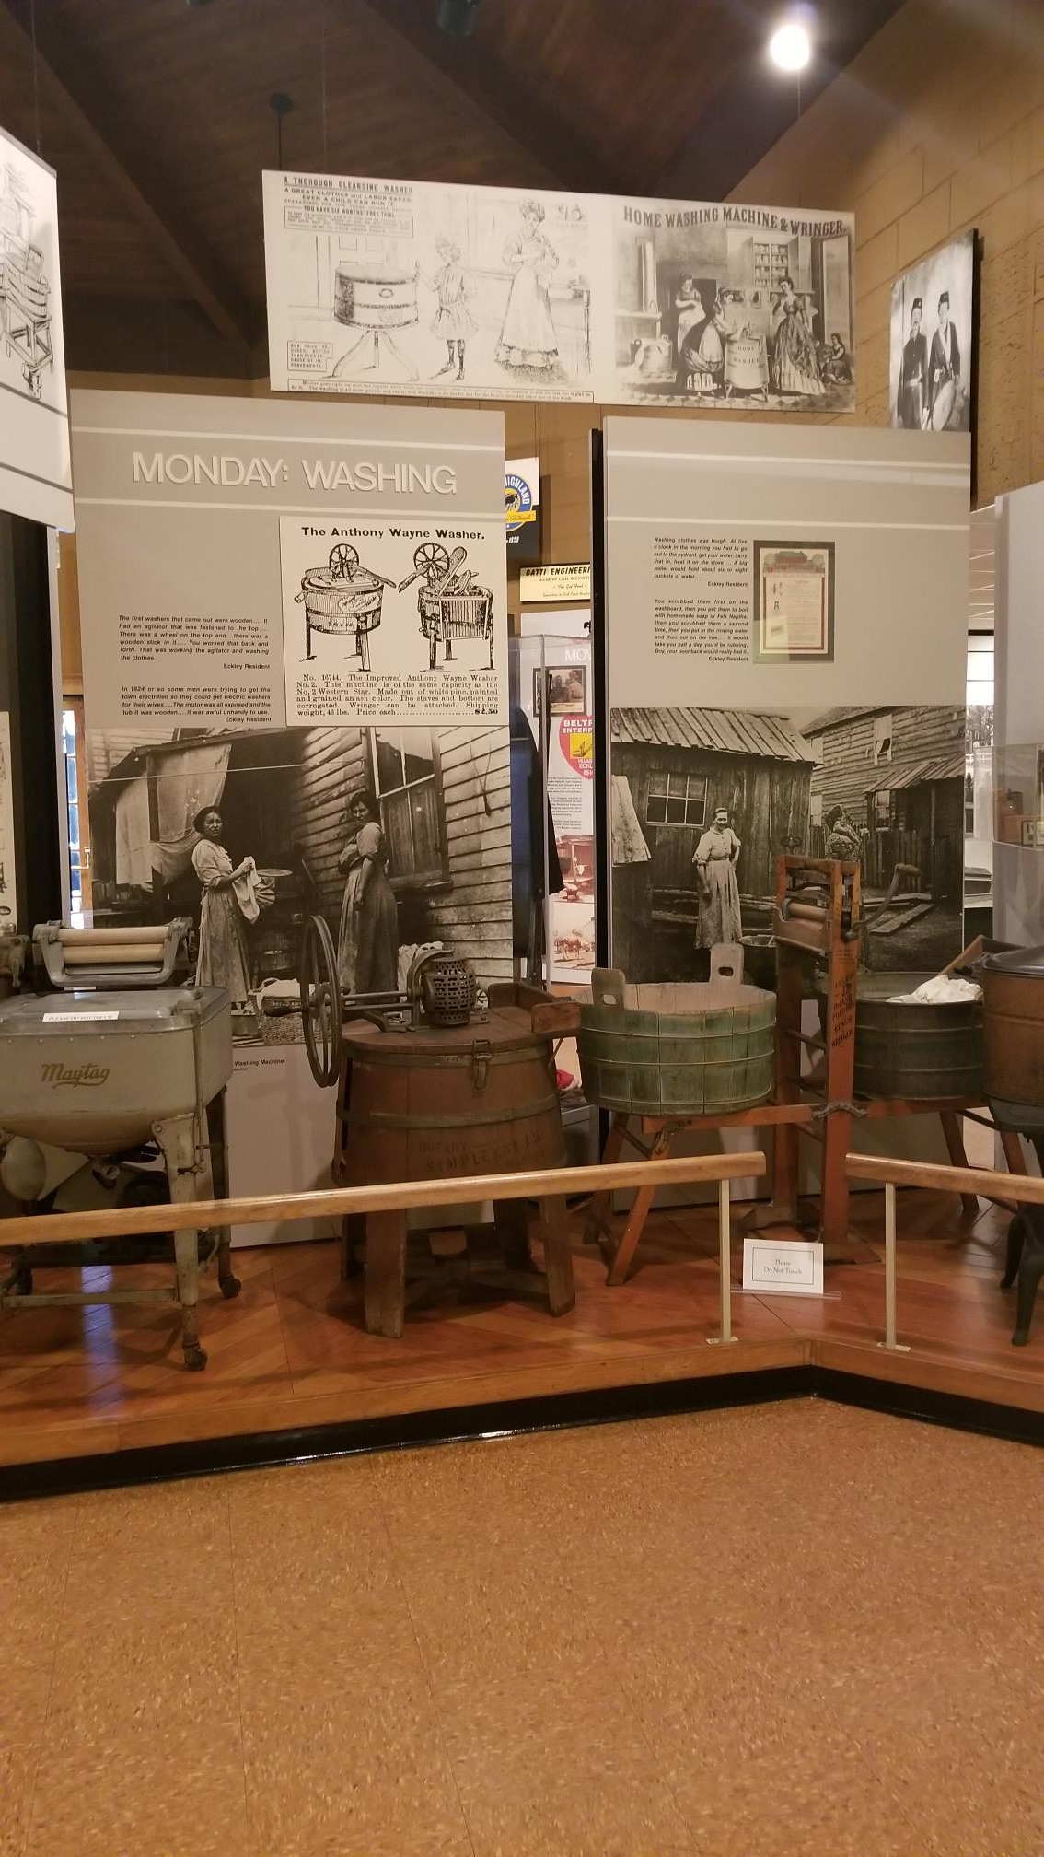
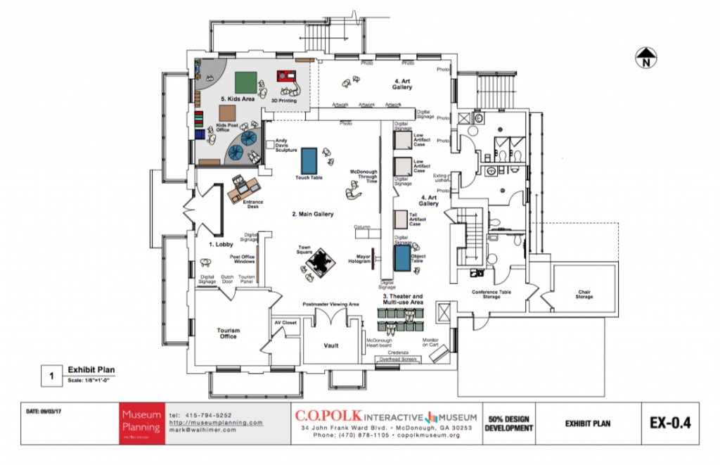
The Who & What of making these museum experiences…
Typical Museum Departments
Registrar and Collections Management
Curatorial
Education
Exhibition Design
Visitor Services
Notes:
There are several different departments in the museum that make exhibits, programs, and events happen. The typical departments are curatorial, education, exhibition design (which might fall under a different department or name), visitors services and very important, the registrar or collections management department.
A collection consists of all the objects as well as the information on the objects in a museum. So, you can imagine that the collections management department, also known as the registrar, is very important. This department handles the accession, or taking in, and deaccession – the process of removing objects from the collection; it keeps the objects safe from damage whether in storage, traveling to other museums, or those on display in exhibits.
The curatorial department usually handles intellectual materials and research as curators are typically the content expert. This means they are the experts on the topics covered in the museum. This department handles directly and/or helps with writing books, articles, and other text on the museum’s collections.
The department that handles the design and making of exhibits is made up all different kinds of professionals. Work in this department involves picking out the objects for the exhibit, building the exhibit space (for example, building walls, cases, domes, and other structures), choosing best lighting for the space, painting it (this sometimes involves artists), choosing the color scheme, and adding technology (interactive parts, computer kiosks, touch screen features, etc). Remember we talked about an interest in construction, carpentry, and web design.
The Education department is there to make information and knowledge about the museum’s collections easy to understand for the public (no matter age, education level, background, etc). The department does this through programs and activities. For example, the education department would typically handle school field trips, tours of the museum, lectures, performances, films, and workshops. They sometimes write for the museum’s website, children’s guides, and brochures.
Visitor Services is very important because it’s the first and last encounter visitors have with the museum – it’s more than just customer service. This department typically handles visitor questions (in the museum, over the phone, and/or via email), ticketing, museum maps, crowd control and traffic, and security is sometimes based out of this department and/or works closely with it.
Links to photos
https://www.flickr.com/photos/nmnh/2647153822
https://museumplanner.org/museum-exhibition-design-definition/

Slide 5
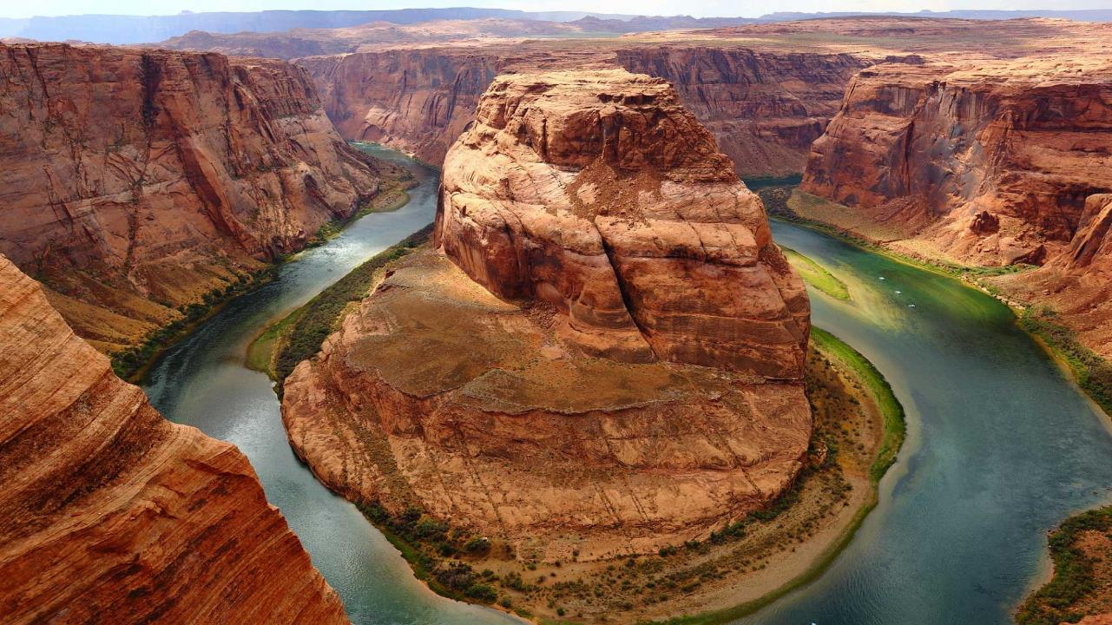
Museum People
Curator Registrar Educator Preparator Conservator
Notes:
(At this point you can proceed through all of the remaining slides or you can ask the students which jobs they are interested in and use the links at the bottom of the slide to go directly to those slides. Keep in mind that there are some jobs that come with videos that you will miss when jumping to specific slides. Please feel free to reorganize slides to fit your group’s needs.)

Slide 6

Registrar – what I do.
Notes:
https://www.youtube.com/watch?v=4Zjm7c8Kbto&index=10&list=PLhlDj_x9osdhYByGSbiEhiDrs4vb2GZnh&t=0s

Slide 7
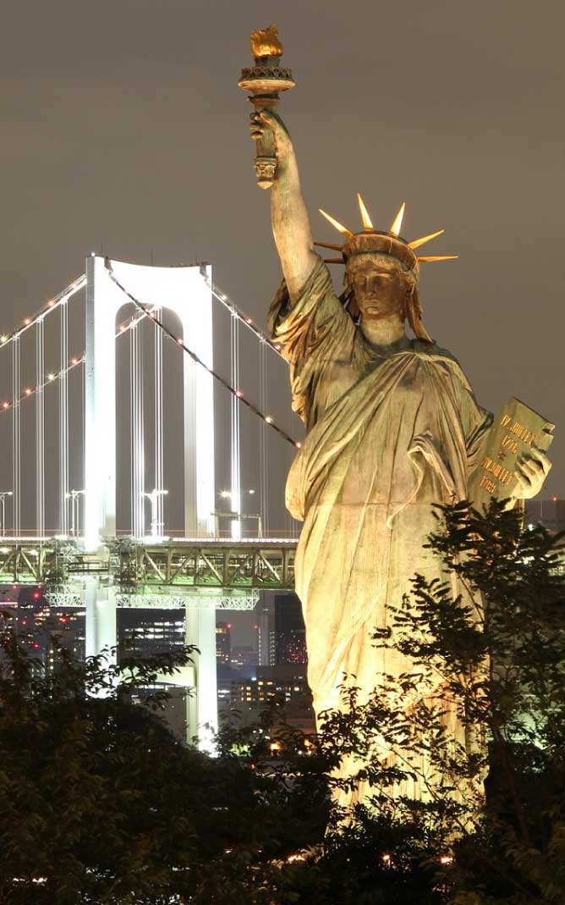
Registrar
Major Job Functions
Responsible for collections (objects in the museum)
Responsible for physical movement of object (within and outside of museum)
Responsible for researching the object
Responsible for maintaining object records
Characteristics/Interests
Very organized
Great time management
Attention to detail
Interest in science a plus
Education
Undergraduate degree in subject specialty of museum
Advanced/graduate degree in museum studies
Training/Internships
Collections management software
Experience working with museum collections
Curator Registrar Educator Preparator Conservator
Notes:
(Read the following description of the Registrar’s job.)
Registrar/collections manager ensures the long-term stability of objects by using proper storage, handling, and maintenance procedures.
(Read the list of Major Job Functions, then read below)
The registrar has to know as much as possible about the objects in the museum’s collection – from where they are in the museum, to how and where they travel when loaned out for exhibition, to the chemical and physical make-up of the object (so they know how to handle it properly). They also help choose objects to be displayed. For example, if the exhibition team wants to display a certain object, they have to talk to the registrar who can tell them things like what kind of light will harm the object, how much moisture can be in the air, and/or if the object can grow fungus if not displayed correctly.
(Click.)
Characteristics/Interests
To be a registrar, you will have to be very organized, pay great attention to detail, and have great time management skills. Interest in science is a plus, but not necessary.
(Click.)
Education
Undergraduate degree in subject specialty of museum- For example, if you want to work in an history museum, an Bachelor’s degree in history or a specific kind of history (like American History) is helpful.
Advanced degree/graduate degree in museum studies – For example, a Master’s degree in museum studies, or a Master’s degree in Library Science is helpful.
(Click.)
Training/Internships
You will want an internship or volunteer experience in a collections department where you can learn how to use collections management software, how to pack and handle objects for transport or exhibit, etc. Even if you are hired in a collections department, you will undergo supervised training before you can handle objects by yourself.

Slide 8
Curator
Major Job Function
Study and interpret museum collection
Organize exhibitions
Publish written works about objects in the museum’s collection
Education
Undergraduate, master’s or doctorate in subject area of museum
Master’s degree in museum studies
Training/Internships
Intern/volunteer experience at museum
Writing in academic setting, preferably about objects
Curator Registrar Educator Preparator Conservator
Notes:
(Read the following job description of a Curator.)
A Curator is the expert on a museum’s collections and exhibitions.
(Read the list of Major Job Functions, then read below)
Remember the curator is the expert on the objects and topics in museum. They study the objects, research them, and make recommendations for expanding the collection. When working on an exhibit, they choose objects, themes, write text, and oversee the general installation. They also write about the objects – this includes books, articles, and catalogs.
(Click.)
Education
You may be able to secure an entry level position with a Bachelor’s degree, but at least a Master’s degree is recommended. You must have a college degree in a specific subject area – for example, American History, Biology, African Art.
(Click.)
Training/Internships
It is recommended to try for an internship or even to volunteer at a museum. You will also need to gain experience with academic writing i.e. publishing written works. This is typically a requirement of a museum’s curator.
Characteristics/Interests - A love for reading, writing, and research are important for anyone that wants to be a curator.

Slide 9
Educator
Major Job Functions
Public programming
Write text and design materials for on- and off-site audiences
Supervise and train volunteers.
Education
Undergraduate degree in education and/or museum subject specialty (required)
Graduate degree in museum studies, museum education, or education in a museum field
Training/Internships
Intern at a museum
Experience teaching or in classroom/child care setting
Curator Registrar Educator Preparator Conservator
Notes:
(Read the following job description of a Educator.)
A Museum Educator instigates, facilitates, and expands the museum’s educational mission by creating and evaluating opportunities for informal learning.
(Read the list of Major Job Functions, then read below)
The major job functions of a museum educator include public programming - for example, tours, lectures, films, internship programs, performances and field trips. The museum educator also writes curriculum and lesson plans, children’s guides, brochures, resource kits for school teachers and families, online materials, etc. They may be consulted when creating exhibits to make sure target audiences are reached. This includes creating programs based on exhibits. For example, if there is an exhibit featuring new dinosaur fossils, the museum’s educator may offer a program to children where they can learn about digging up dinosaurs/fossils and provide an associated hands-on project.
(Click.)
Education
At minimum, a bachelor’s degree in education and/or subject specialty like Art, Biology, History, etc is required. If you would like a supervisory/manager position, then at least a Master’s in Museum Studies, or Museum Education, or something like Art Education is recommended.
(Click.)
Training/Internships
An internship or volunteer experience in a museum’s education department is recommended. Experience teaching or in a child care setting (such as a classroom, as a camp counselor, as a tour guide/volunteer) is also helpful. The key takeaway is experience working with groups of children, teens, etc.
Characteristics/Interests - This is a job where working with the public, with children and people from diverse backgrounds, having patience, and a love for both formal and informal education is important. Being creative is a plus.

Slide 10
Preparator (Art) – what I do.
Notes:
https://www.youtube.com/watch?v=QX2b74HtmrA

Slide 11
Preparator (Natural History/Sciene) – what I do.
Notes:
https://www.youtube.com/watch?v=QX2b74HtmrA

Slide 12
Preparator
Major Job Functions
Prepare objects for display
Install and de-install exhibits
Preparing space for exhibits
Education
High school diploma or GED required, especially mixed with hands-on experience
Undergraduate degree helpful
Advanced degree in museum studies required for senior positions
Training/Internships
Internship, or volunteering helpful in museum setting
Carpentry or construction experience helpful
Curator Registrar Educator Preparator Conservator
Notes:
(Read the following job description of a Preparator.)
A Preparator prepares objects for display – install, de-install entire exhibitions including painting and constructing temporary walls, hanging art and panels on the walls, assembling interactive components and building cases, and placing labels and adjusting lights for maximum affect.
(Major job functions covered in job description.)
(Click.)
Education
A high school diploma is required. A bachelor’s degree is recommended especially in programs that offer carpentry, construction, photography, and/or woodwork. For senior positions, an advanced degree – a Master’s degree in museum studies, for example – is recommended.
(Click.)
Training/Internships
An internship or volunteer experience with the major job functions is highly recommended. Again these include carpentry, woodwork, construction, photography. Often museums will hire and train temporary crews to help prepare objects for transportation – these are typically fairly easy experiences to secure.
Characteristics/Interests – Interest in working with your hands, painting and learning how to use different tools, and the ability to lift heavy objects are important if you want to be a preparator.

Slide 13
Conservator – what I do.
Notes:
https://www.youtube.com/watch?v=GmPeMcLuBMo&list=PLhlDj_x9osdhYByGSbiEhiDrs4vb2GZnh&index=8&t=69s

Slide 14
Conservator
Major Job Functions
Repair, restore, clean, and preserve objects
“image, analyze, and treat objects” (Schlatter, 2008) using special software and equipment
Education
Undergraduate degree required – studio art and/or chemistry
Advanced degree in conservation
Specialized knowledge in various media
Training/Internships
Apprenticeships
Experience working with objects
Curator Registrar Educator Preparator Conservator
Notes:
(Read the following job description of a Conservator.)
The Conservator protects, prepares, restores, cleans and preserves objects in the museum’s collection.
(Read the list of Major Job Functions, then read below)
The conservator repairs, restores, cleans, and preserves the museum’s objects through the use of science, extensive experience with specific kinds of objects (for example, books, furniture, metals, textiles, etc), special software, and equipment.
(Click.)
Education
If you want to be a conservator, you are required to have at least a Bachelor’s degree in studio art and/or chemistry. For any position higher than conservation assistant, you will also need an advanced degree in conservation.
(Click.)
Training/Internships
Through schooling and an apprenticeship, internship, and/or fellowship, you will gain required experience with and specialized knowledge of specific kinds of objects. A conservator has to know how to work with (repair, clean, restore, and preserve) several kinds of objects, but specialization in one medium is also helpful. For example, experience and extensive knowledge on how to work with books will make you more likely to secure a job in a place like the Trinity College Library – a famous library in Dublin, Ireland.
Characteristics/Interests - This is a job that takes extreme dedication, a love of science, steady hands, and great attention to detail.
Schlatter, Elizabeth N. (2008) Museum Careers A Practical Guide for Students and Novices.

Slide 15
Where do I look for museum job posts?
Common websites to look for museum job postings include:
https://aam-us-jobs.careerwebsite.com/
www.museum-employment.com
www.museumjobs.com
www.hireedjobs.com
www.nonprofit.careerbuilder.com
Or, on a specific museum’s website directly
Notes:
Explore these websites with your students to help them get feel for navigating through job postings, and so that they can see typical and recent requirements for some of the positions they might be interested in.
[End of Presentation]
__________________________________________________________________________________
Thank you for using this presentation. If you would like to learn more, please return to our website www.eckleyminersvillagemuseum.com.
If you would like a museum professional to come speak with your class, please call the museum at (570) 636 – 2070 or email the Education and Volunteer Coordinator, Nicole Negron, at c-nnegron@pa.gov.

